Slide 1
Information System
ITEC-522
First Semester Third Year
Information Technology
Dr. Khalil-ur-Rahmen Khoumbati
Professor
Department of Information Technology
Faculty of Engineering and Technology
University of Sindh, Jamshoro
Khalil.khoumbati@gmail.com
Week #7

Slide 2
Information Systems, Organizations, and Strategy

Slide 3
Organizations and Information Systems
Information technology and organizations influence one another
  Complex relationship influenced by organization’s structure, business processes, politics, culture, environment, and management decisions.

Slide 4
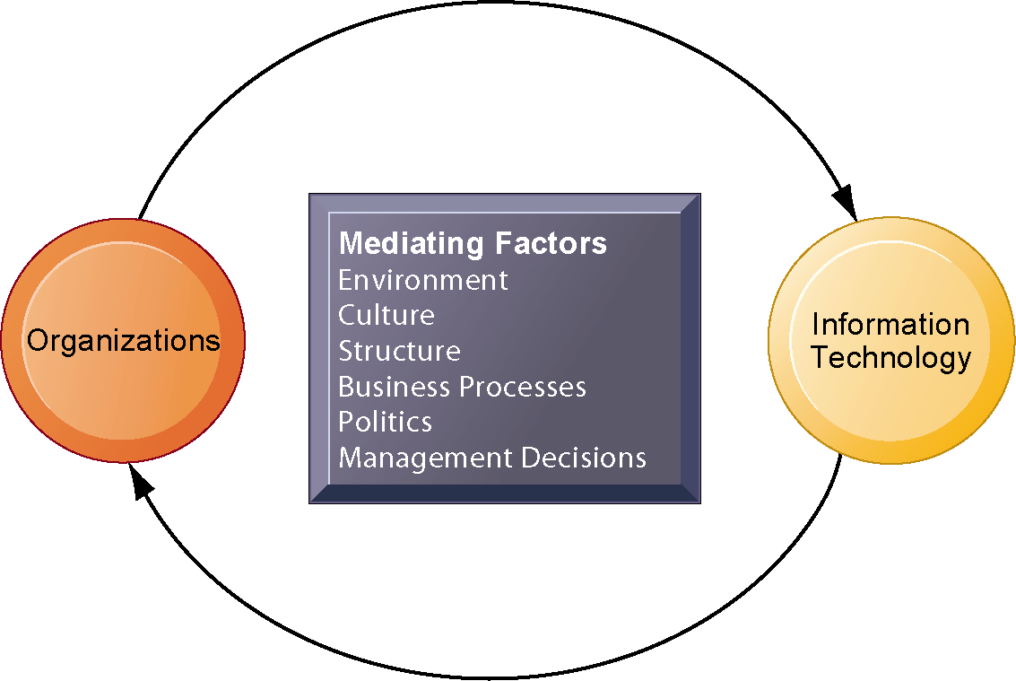
Organizations and Information Systems
The Two-Way Relationship Between Organizations and Information Technology
This complex two-way relationship is mediated by many factors, not the least of which are the decisions made—or not made—by managers. Other factors mediating the relationship include the organizational culture, structure, politics, business processes, and environment.

Slide 5
Organizations and Information Systems
What is an organization?
  Technical definition:
    Stable, formal social structure that takes resources from environment and processes to produce outputs.
    A formal legal entity with internal rules and procedures, as well as a social structure
  Behavioral definition:
    A collection of rights, privileges, obligations, and responsibilities that is delicately balanced over a period of time through conflict and conflict resolution

Slide 6
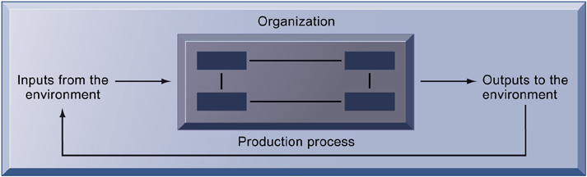
Organizations and Information Systems
The Technical Microeconomic
Definition of the Organization
In the microeconomic definition of organizations, capital and labor (the primary production factors provided by the environment) are transformed by the firm through the production process into products and services (outputs to the environment). The products and services are consumed by the environment, which supplies additional capital and labor as inputs in the feedback loop.

Slide 7
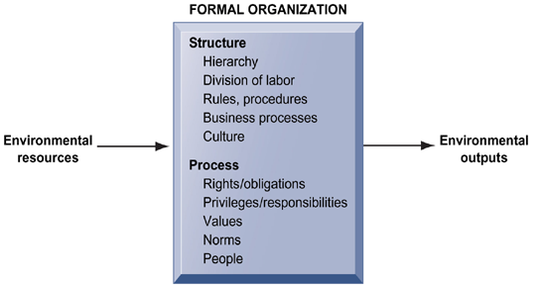
Organizations and Information Systems
The Behavioral View of Organizations
The behavioral view of organizations emphasizes group relationships, values, and structures.

Slide 8
Organizations and Information Systems
Features of organizations
  All modern organizations share some characteristics, such as:
      Use of hierarchical structure
      Accountability, authority in system of impartial decision-making
      Adherence to principle of efficiency
      Other features include: Routines and business processes and organizational politics, culture, environments and structures

Slide 9
Organizations and Information Systems
Organizational politics
  Divergent viewpoints lead to political struggle, competition, and conflict
  Political resistance greatly hampers organizational change

Slide 10
Organizations and Information Systems
Organizational culture:
  Encompasses set of assumptions that define goal and product
    What products the organization should produce
    How and where it should be produced
    For whom the products should be produced
  May be powerful unifying force as well as restraint on change

Slide 11
Organizations and Information Systems
Organizational environments:
  Organizations and environments have a reciprocal relationship
  Organizations are open to, and dependent on, the social and physical environment
  Organizations can influence their environments
  Environments generally change faster than organizations
  Information systems can be instrument of environmental scanning, act as a lens

Slide 12
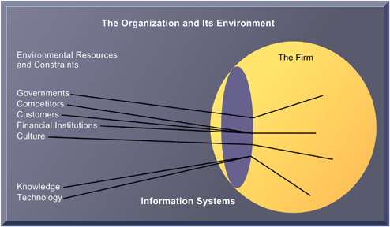
Organizations and Information Systems
Environments and Organizations
Have a Reciprocal Relationship
Environments shape what organizations can do, but organizations can influence their environments
and decide to change environments altogether. Information technology plays a critical role in helping
organizations perceive environmental change and in helping organizations act on their environment.

Slide 13
Organizations and Information Systems
Organizational structure
  Five basic kinds of structure
    Entrepreneurial: Small start-up business
    Machine bureaucracy: Midsize manufacturing firm
    Divisionalized bureaucracy: Fortune 500 firms
    Professional bureaucracy: Law firms, school systems, hospitals
    Adhocracy: Consulting firms

Slide 14
Organizations and Information Systems
Other Organizational Features
  Goals
  Constituencies
  Leadership styles
  Tasks
  Surrounding environments

Slide 15
Business Strategy
"Strategy is the direction and scope of an organisation over the long-term: which achieves advantage for the organisation through its configuration of resources within a challenging environment, to meet the needs of markets and to fulfil stakeholder expectations".
In other words, strategy is about:
* Where is the business trying to get to in the long-term (direction)
* Which markets should a business compete in and what kind of activities are involved in such markets? (markets; scope)
* How can the business perform better than the competition in those markets? (advantage)?

Slide 16
Business Strategy
* What resources (skills, assets, finance, relationships, technical competence, facilities) are required in order to be able to compete? (resources)?
* What external, environmental factors affect the businesses' ability to compete? (environment)?
* What are the values and expectations of those who have power in and around the business? (stakeholders)

Slide 17
Business Strategy
Strategy at Different Levels of a Business
Strategies exist at several levels in any organisation - ranging from the overall business (or group of businesses) through to individuals working in it.
Corporate Strategy - is concerned with the overall purpose and scope of the business to meet stakeholder expectations. This is a crucial level since it is heavily influenced by investors in the business and acts to guide strategic decision-making throughout the business. Corporate strategy is often stated explicitly in a "mission statement“.

Slide 18
Business Strategy
Business Unit Strategy - is concerned more with how a business competes successfully in a particular market. It concerns strategic decisions about choice of products, meeting needs of customers, gaining advantage over competitors, exploiting or creating new opportunities etc.
Operational Strategy - is concerned with how each part of the business is organised to deliver the corporate and business-unit level strategic direction. Operational strategy therefore focuses on issues of resources, processes, people etc.

Slide 19
Strategic Planning
First Stage of Strategic Planning may involve:
Futures Thinking
  Thinking about what the business might need to do 10–20 years ahead
Strategic Intents
  Thinking about key strategic themes
  that will inform
  decision making
“The thicker the planning document, the more useless
it will be”

Slide 20
Strategic Planning
The Vision
  Communicating to all staff where the organisation is going and where
  it intends to be in the future
  Allows the firm to set goals
Aim and Objectives:
  Aim– long term target
  Objectives – the way in which you are going to achieve the aim

Slide 21
Strategic Planning
Example:
Aim may be for a chocolate manufacturer to break into
a new overseas market
Objectives:
  Develop relationships with overseas suppliers
  Identify network of retail outlets
  Conduct market research to identify consumer needs
  Find location for overseas sales team HQ

Slide 22
Strategic Planning
Once the direction is identified:
Analyse position
Develop and introduce strategy
Evaluate:
  Evaluation is constant and the results of the evaluation feed back
  into the vision

Slide 23
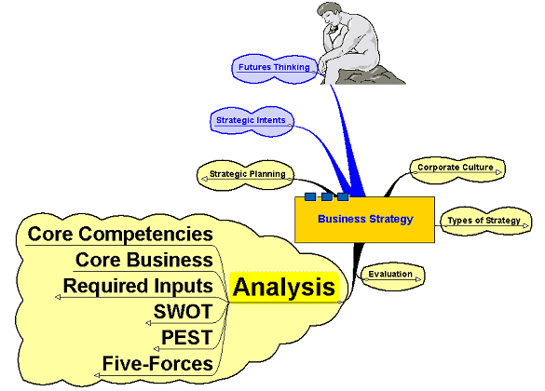
Analysis

Slide 24
SWOT
Strengths – identifying existing organisational strengths
Weaknesses – identifying existing organisational weaknesses
Opportunities – what market opportunities might there be
for the organisation to exploit?
Threats – where might the threats
to the future success come from?

Slide 25
PEST
Political: local, national and international political developments – how will they affect the organisation and in what way/s?
Economic: what are the main economic issues – both nationally and internationally – that might affect the organisation?
Social: what are the developing social trends that may impact on how the organisation operates and what will they mean for future planning?
Technological: changing technology can impact on competitive advantage very quickly!

Slide 26
PEST
Examples:
Growth of China and India as manufacturing centres
Concern over treatment of workers and the environment in less developed countries who may be suppliers
The future direction of the interest rate, consumer spending, etc.
The changing age structure of the population
The popularity of ‘fads’ like the Atkins Diet
The move towards greater political regulation of business
The effect of more bureaucracy in the labour market

Slide 27
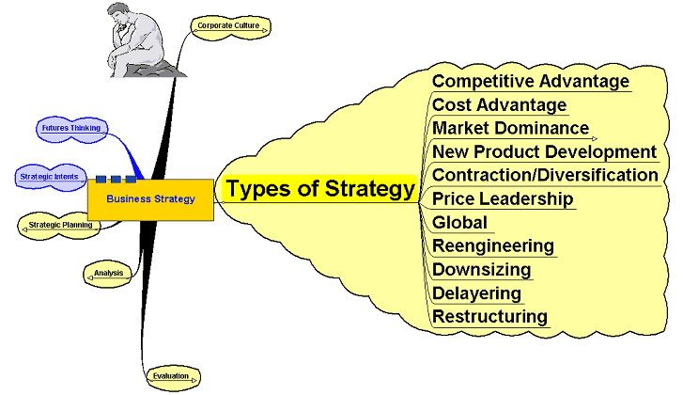
Types of Strategy

Slide 28
Types of Strategy
Competitive Advantage – something which gives the organisation some advantage over its rivals
Cost advantage – A strategy to seek out and secure a cost advantage
of some kind - lower average costs, lower labour costs, etc.

Slide 29
Types of Strategy
Market Dominance:
Achieved through:
  Internal growth
  Acquisitions – mergers and takeovers
New product development: to keep ahead of rivals and set the pace
Contraction/Expansion – focus on what you are good at (core competencies) or seek to expand into a range of markets?

Slide 30
Types of Strategy
Price Leadership – through dominating the industry – others follow your price lead
Global – seeking to expand
global operations
Reengineering – thinking outside the box – looking at news ways of doing things to leverage the organisation’s performance

Slide 31
Types of Strategy
  Internal business level strategies –
Downsizing – selling off unwanted parts of the business – similar
to contraction
Delayering – flattening the management structure, removing bureaucracy, speed up decision making
Restructuring – complete re-think
of the way the business is organised

Slide 32
Discussion
Questions?

